Slide 1
COVID-19 Situation update – 02 April 2020

Slide 2
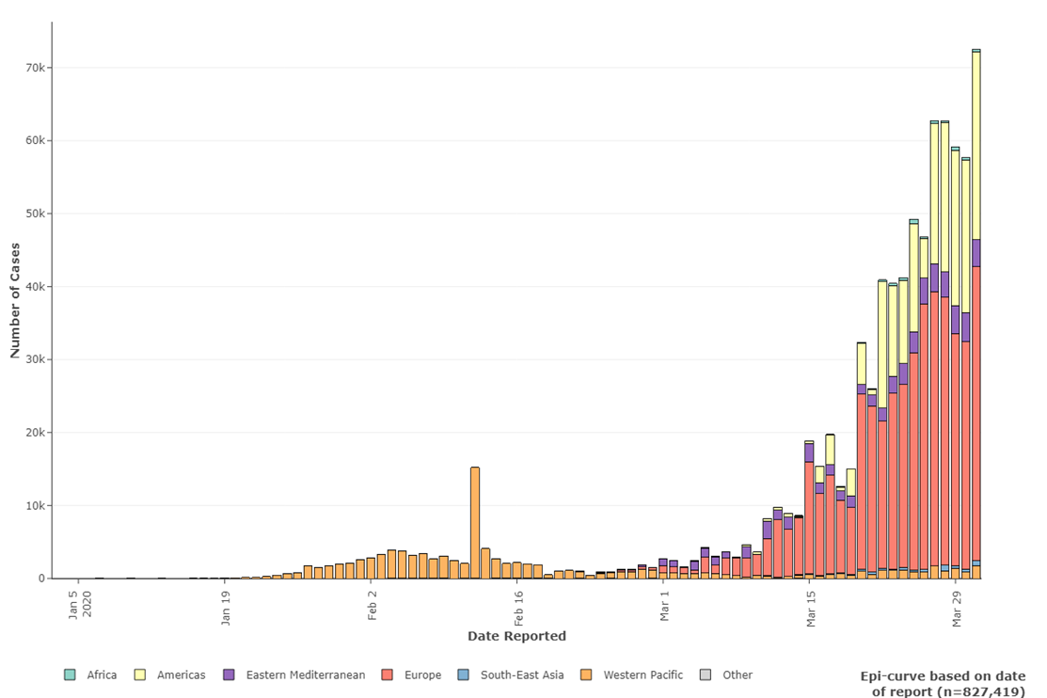
Current Situation (As of 01 Apr, 18H Geneva Time)
Between 31 Dec 2019 - 01 Apr 2020
827,419 cases from 205 countries/states/territories and 1 international conveyance
40,777 deaths from 127 countries/states/territories and 1 international conveyance
10 countries with highest number of cumulative cases:
United States of America (163199)
Italy (105792)
Spain (94417)
China (82638)
Germany (67366)
France (51477)
Iran (Islamic Republic of) (47593)
The United Kingdom (25154)
Switzerland (16108)
Turkey (13531)
10 countries with most reported number of cases in past 24 hours:
United States of America (22559)
Spain (9222)
France (7500)
Germany (5453)
Italy (4053)
The United Kingdom (3009)
Iran (Islamic Republic of) (2987)
Turkey (2704)
Canada (1378)
Portugal (1035)

Slide 3
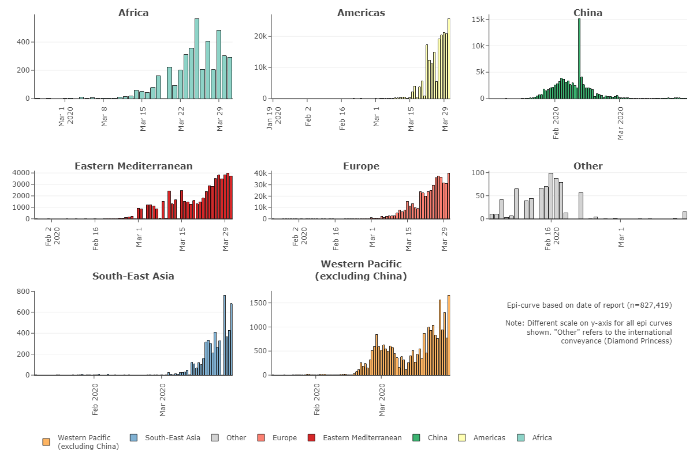
Number of confirmed cases notified under IHR or from official government sources by WHO region, for China, and International Conveyance (Diamond Princess) as of 01 Apr 18H

Slide 4
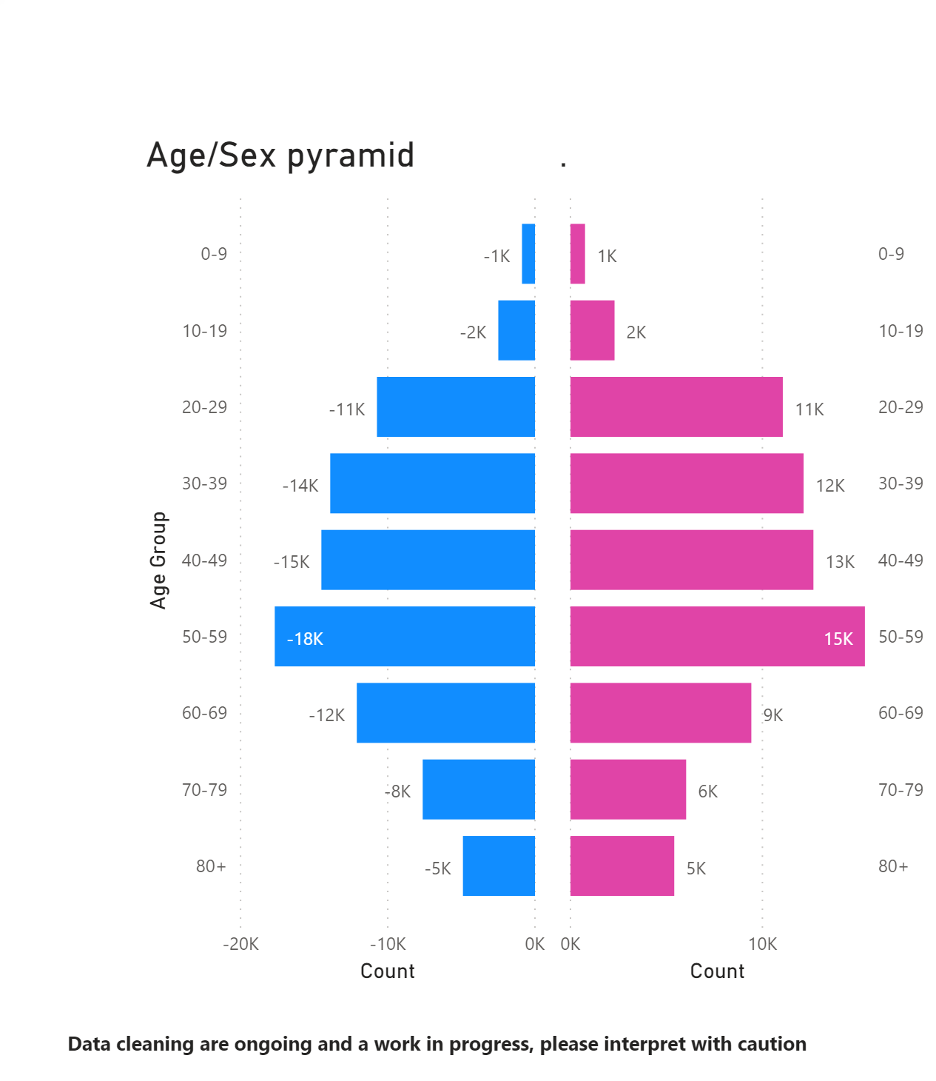
Total # of cases with sex and age information (n=159 504)
Sex | Percentage
Female | 47%
Male | 52%
Unknown | 1%
Age | Percentage
0-9 | 1.0%
10-19 | 2.9%
20-29 | 13.4%
30-39 | 16.2%
40-49 | 17.0%
50-59 | 20.7%
60-69 | 13.5%
70-79 | 8.6%
80 + | 6.6%

Slide 5
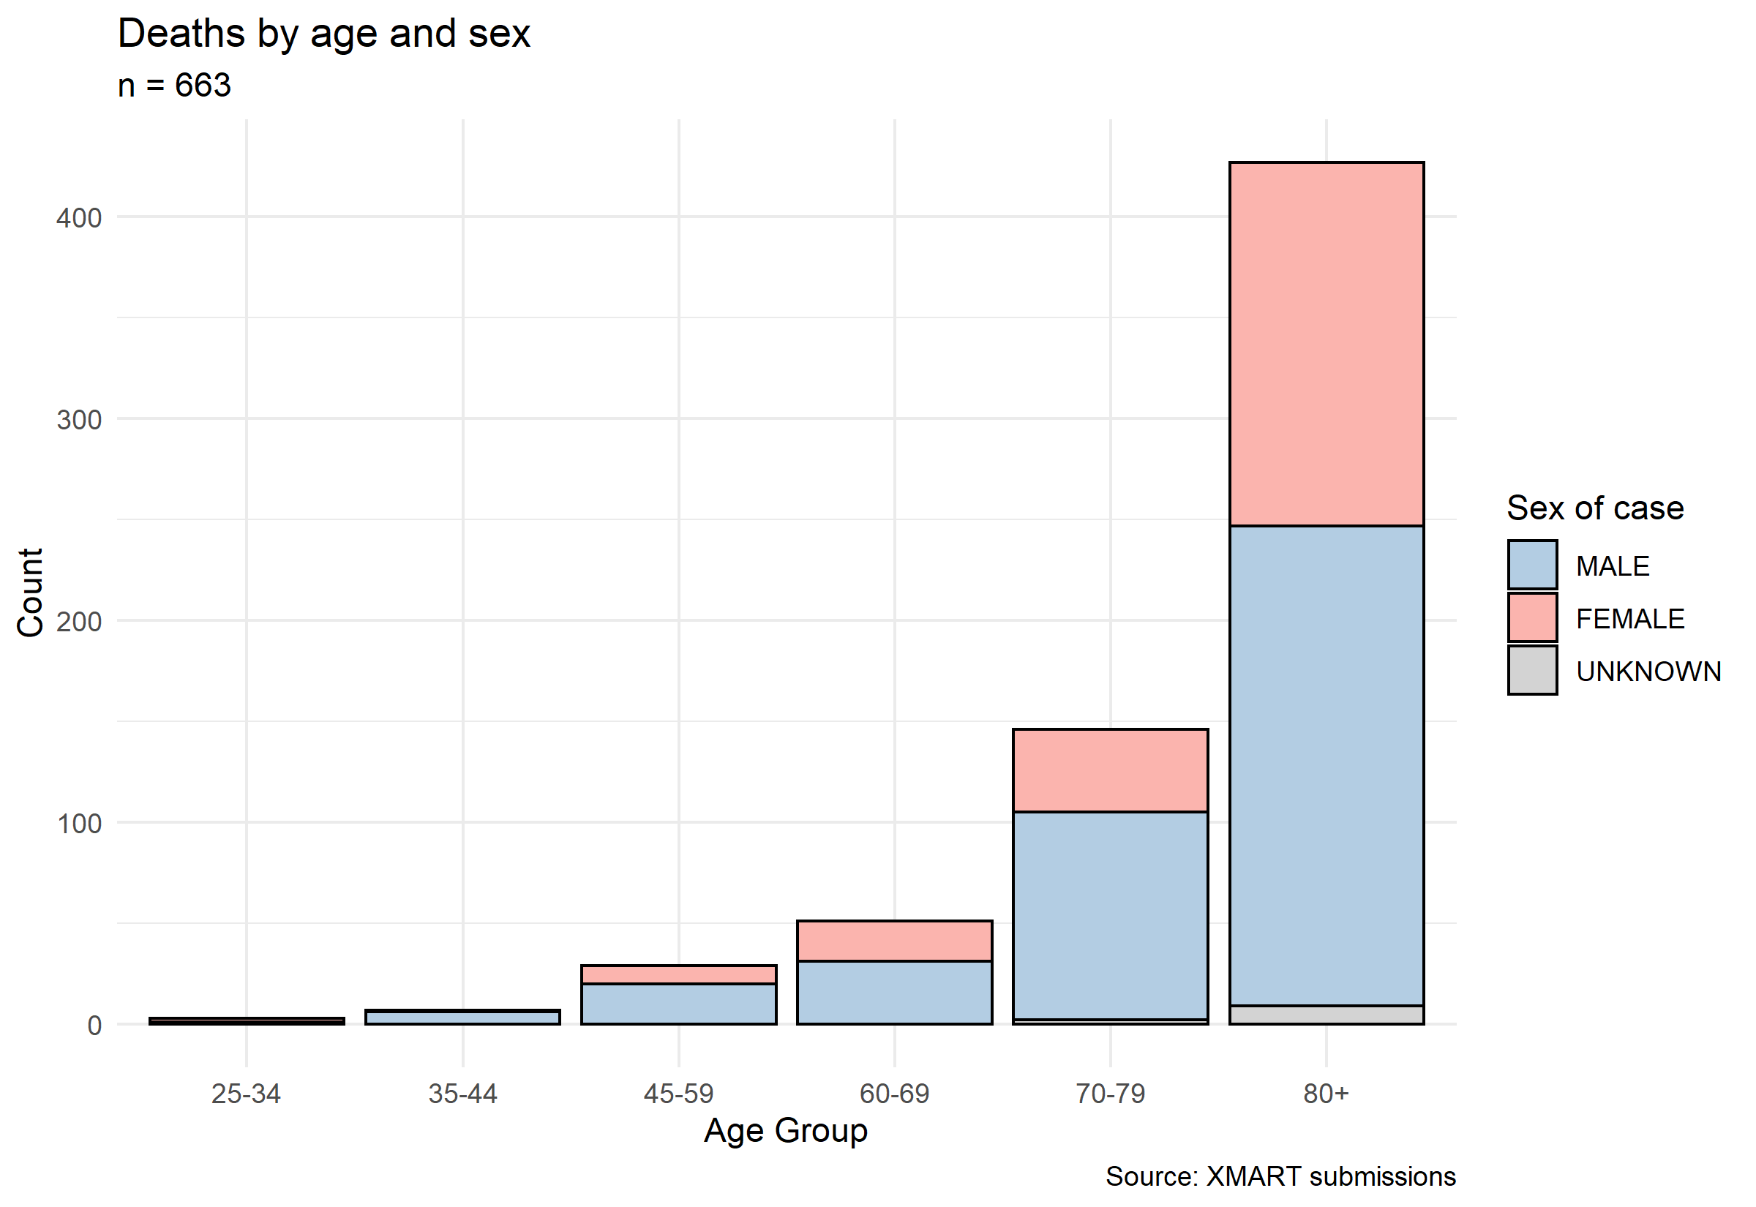
Total # of recorded deaths by sex and age group
Female: 253 (38.1%)
Male: 499 (60.2 %)
Note: Most death reports are from EURO Member States

Slide 6
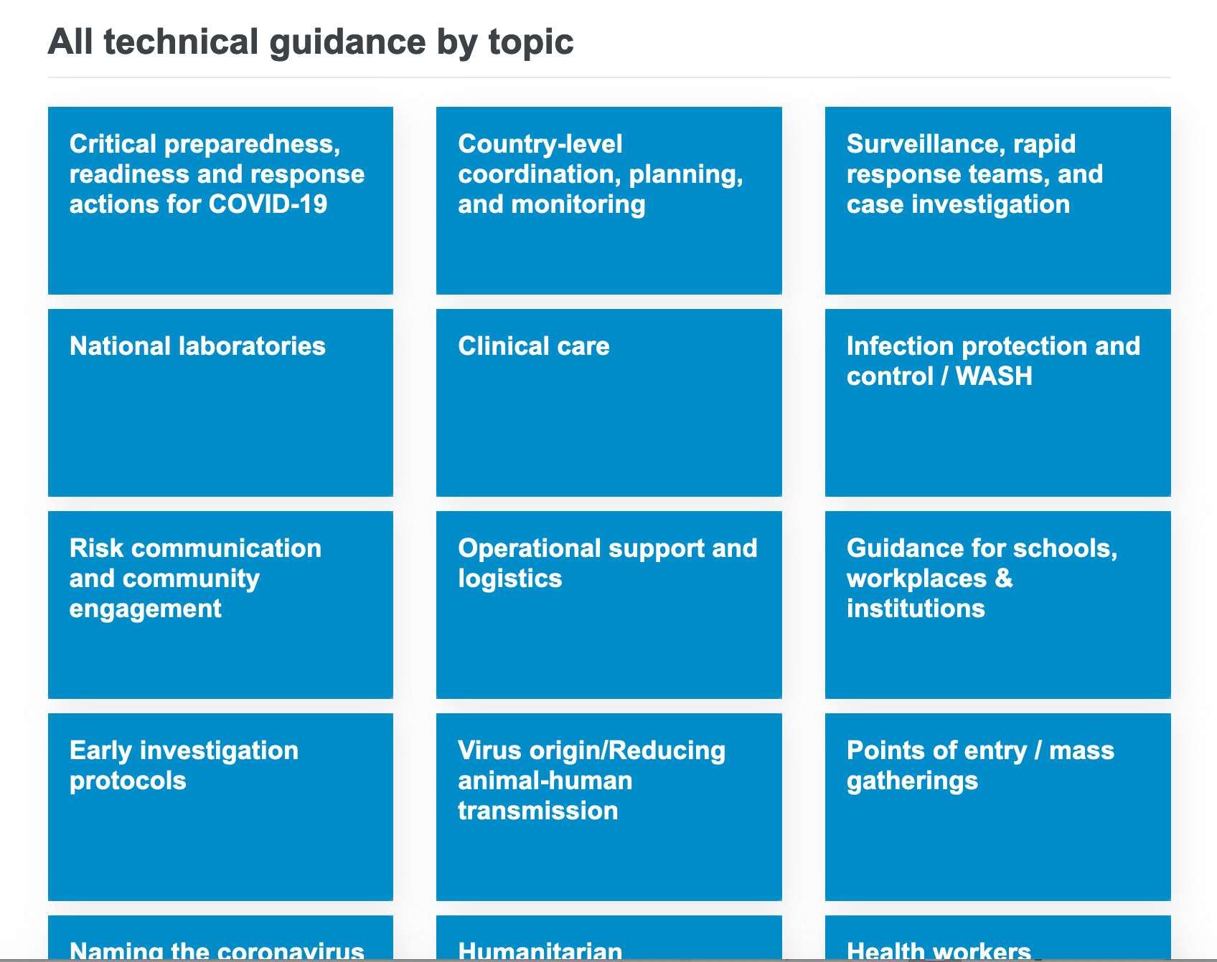
COVID-19 Updates/New technical guidance
New Guidance
Surveillance: Operational considerations for surveillance of COVID-19 using GISRS
Clinical care: Severe Acute Respiratory Infections Treatment Centre: Practical manual
Logistics: Essential Supplies Forecasting Tool
Lab: Guidance for laboratories shipping specimens to WHO reference laboratories that provide confirmatory testing for COVID-19 virus
https://www.who.int/emergencies/diseases/novel-coronavirus-2019/technical-guidance

Slide 7
COVID-19 New technical guidance (continued) and Scientific Briefs
Additional new guidance
Maintaining essential health services
COVID-19: Operational guidance for maintaining essential health services during an outbreak
Guiding principles for immunization activities during the COVID-19 pandemic
Operational considerations for COVID-19 management in the accommodation sector (Hotels)
Scientific Briefs (New technical product)
Scientific summaries of available evidence on specific topics:
Modes of transmission of virus causing COVID-19: implications for IPC precaution recommendations
Off-label use of medicines for COVID-19
Origin of SARS-CoV-2

Slide 8
Thank you

